Slide 1
Predicting spectral channels related to mineralogy from CRISM spectral bands using deep learning
Name : Aman Sahani
Matriculation: 12201412
Supervisor - Prof. Dr. Benedikt Elser

Slide 2
Table of Content
Introduction
Motivation
Background
Methodology
Dataset Creation
Model Architecture
Results
Conclusion
Research Questions

Slide 3
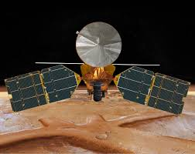
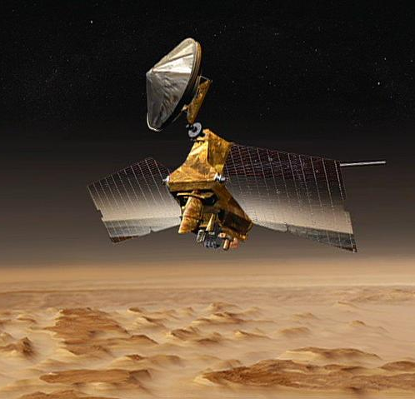
Introduction
Mars Reconnaissance Orbiter (MRO): NASA’s MRO is a spacecraft used to capture detailed data from mars using specific instruments attached to it.

Slide 4
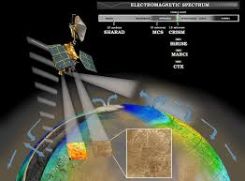
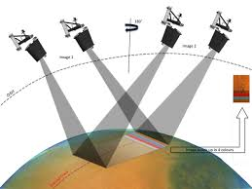
MRO Instruments
CRISM
Images from 362nm to 3920 nm
Captures 544 spectral bands
Used to identify minerals
No longer functional
CaSSIS
Images from 400nm to 1100nm
Captures 4 spectral bands
Used to take color and stereo images
Still functioning and capturing images

Slide 5
Motivation
Motivation: Motivation stems from combining CRISM’s detailed spectral data with CaSSIS’s broader spatial coverage.
Objective: Convert CRISM data to the four spectral bands of CaSSIS and predict additional mineralogical channel.
Method: Use a Diffusion Generative Model to leverage the independence of CRISM's spectral bands

Slide 6
Research Questions
Generate feature and output training samples from CRISM dataset
Can traditional image models such as unet predict new band in image
How to design and implement a diffusion model to predict carbonate channel
How can the model be evaluated for predicting new channel

Slide 7
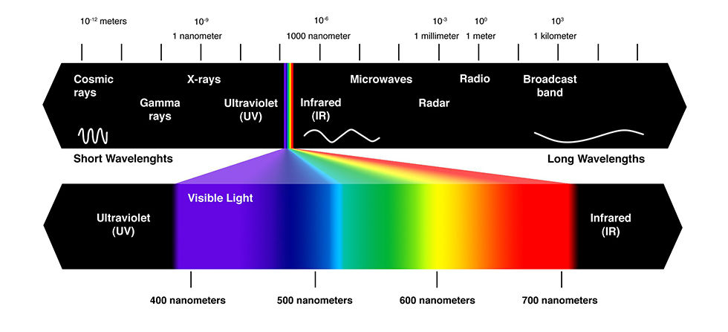
Background Spectral Lines in Mineralogy and Planetary Science
UV used to detect specific minerals and study atmosphere
IR Used to detect thermal emissions and identify water
Observe planetary surface and identify mineral composition

Slide 8
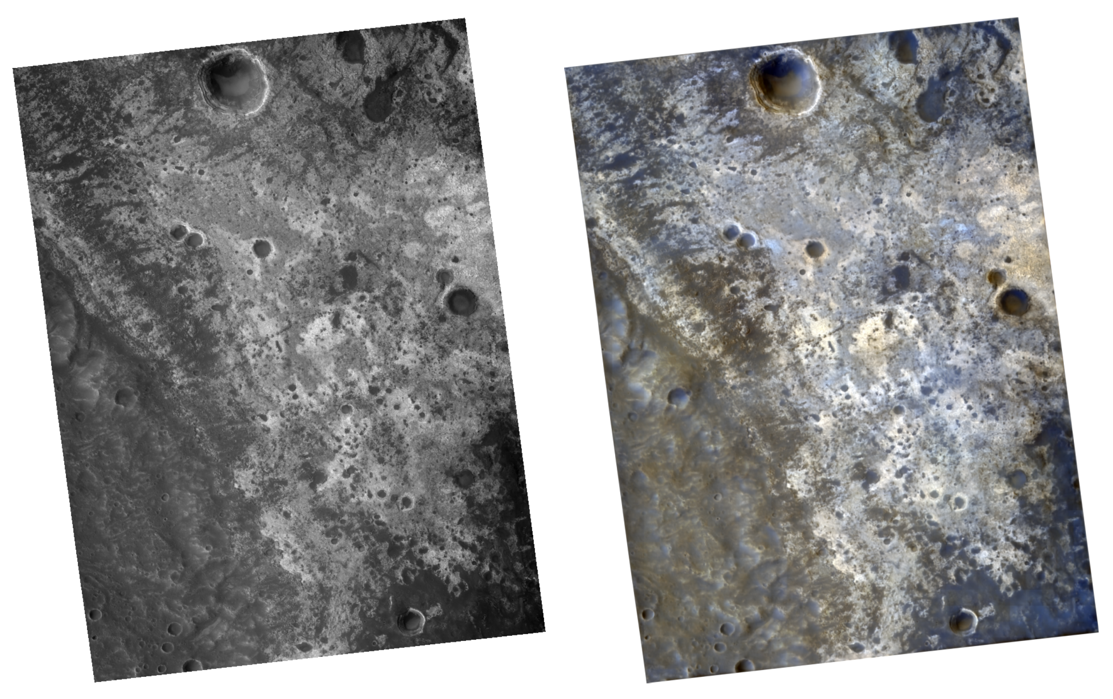
Related Work
Stepcenkov (2022) predicted three color channels from black-and-white CTX image using Neural Network (Unet model) but produced unsatisfactory results to predict NIR channel.
Objective of the project is to use diffusion model’s generative capabilities to predict NIR channel.

Slide 9
Methodology

Slide 10
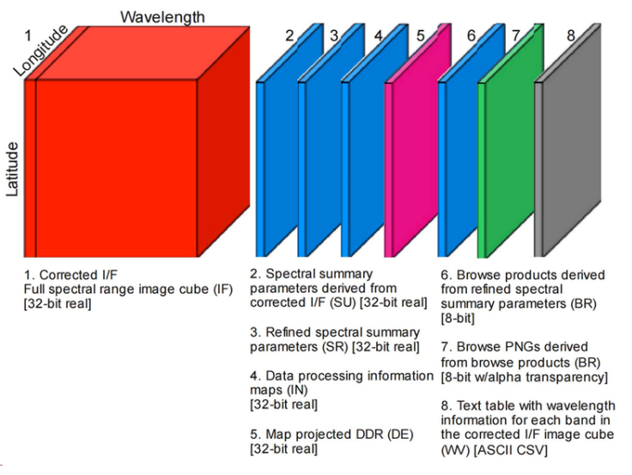
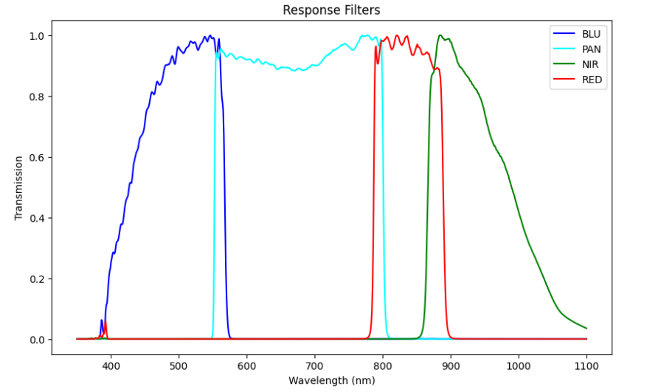
Dataset
CRISM MTRDR product contains several products, in the context of this research, we will be working on correct I/F or IF and refned spectral summary parameters or SR to generate input and output images for the model respectively.
CaSSIS contains 4 channels that are - Blue channel (BLU), Panchromatic Channel (Pan), Near-Infrared (NIR) Channel, and Red Channel (RED), applying these filter to CRISM we can transform it into CaSSIS

Slide 11
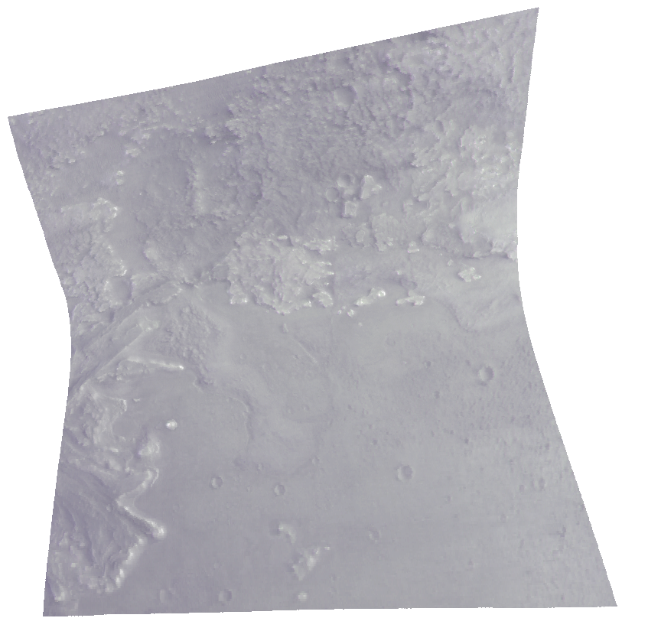
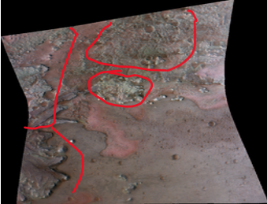
Dataset Creation
The spectral cube from I/F product is taken and apply the CaSSIS filter on the spectral cube to get 4 bands –pan, nir, red and blue. The converted image will be used as input image.
The summary browse product or the SR product is taken and apply filter to get the carbonates band ("R1080","R1506","R2529“) and transform them into image which will be used as output image.
Input Image
Output Image
Data in MTRDR format collected from (https://oderest.rsl.wustl.edu/#ODERESTInterface)
Notes:
The simplest browse products, such as enhanced visible color (see Figure 3) or false color, are constructed by setting each RGB channel to one specific reflectance band.

Slide 12
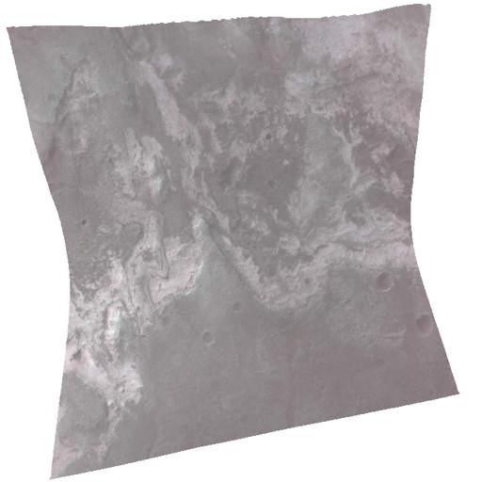
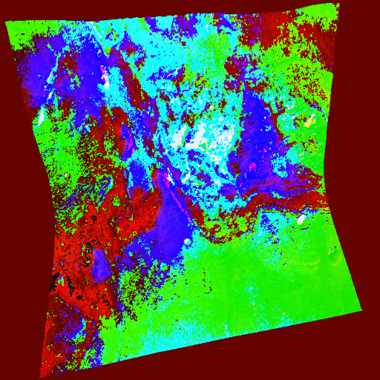
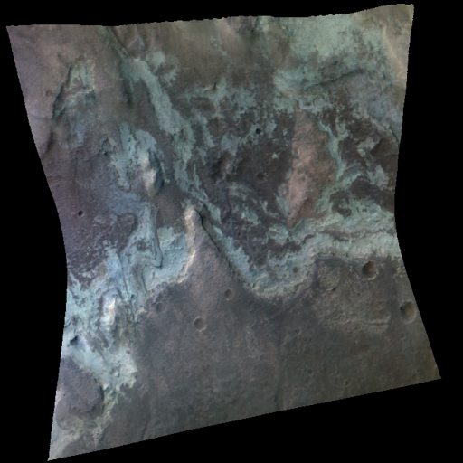
Dataset Creation
The stable diffusion model is trained on 3 channels therefore we need to further convert it into 3 channels. To do this –
Chose PAN, NIR and RED channels as they contain more information
Applied PCA to reduce one dimension
Perfomed data augmentation
PNR Image PCA Image Output image ( carbonates )

Slide 13
Architecture of Diffusion model
Output image with carbonate band predictions
VAE-Encoder
VAE-Decoder
U-Net (Finetuned with existing weights )
3 channel input images
CLIP Text Encoder (Frozen)
Predict Carbonates

Slide 14
Predicting carbonates channel using traditional image model
Results

Slide 15
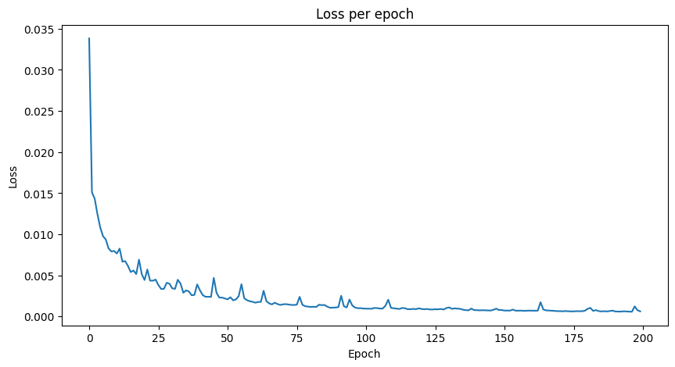
Unet Results On PNR Dataset
Metrics | Unet Scores
Average RMSE | 6.967
Average PCC | 0.961
Average Cosine Similarity | 0.986
Average SSIM | 0.915
Average lpips | 0.128

Slide 16
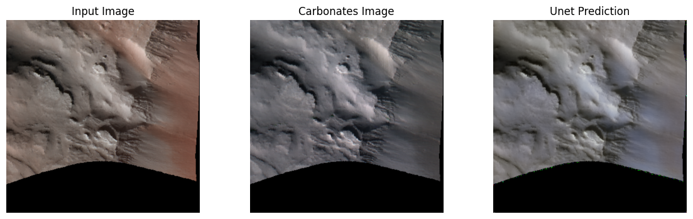
Skewness in Unet Results
Skewed Result as data with no carbonates are abundant
Images without carbonates are captured adequately by unet
Notes:
Unet is able to capture structure but since there are no carbonates, it results in very similar images improving the score

Slide 17
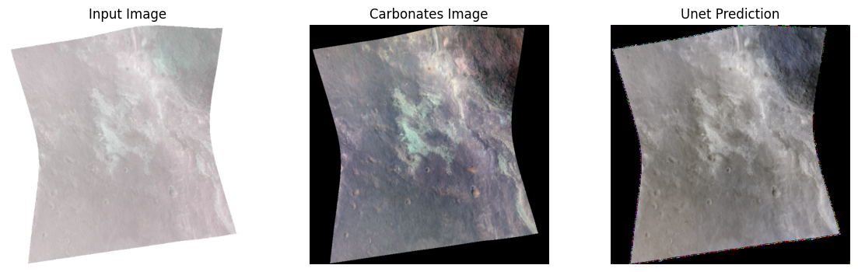
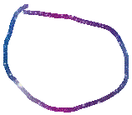

Skewness in Results
Here It‘s clearly visible that unet is not able to capture the green carbonates signatures

Slide 18
Updated Data Metrics
The metrics also indicate this when I calculated in on smaller dataset where carbonates were present.
Metrics | Unet Score
Average RMSE | 7.364
Average PCC | 0.931
Average Cosine Similarity | 0.975
Average SSIM | 0.882
Average lpips | 0.169

Slide 19
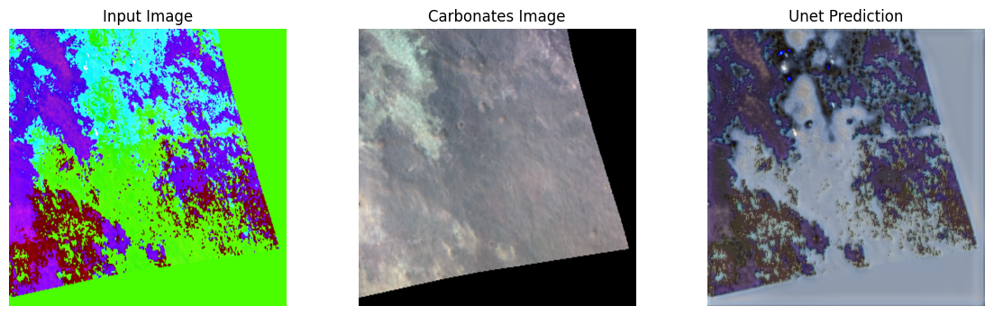
Unet Results on PCA dataset
Unet performed worse on pca, which was expected as it was unable to generalize colors on original pca images.

Slide 20
Predicting carbonates channel using diffusion model
Results

Slide 21
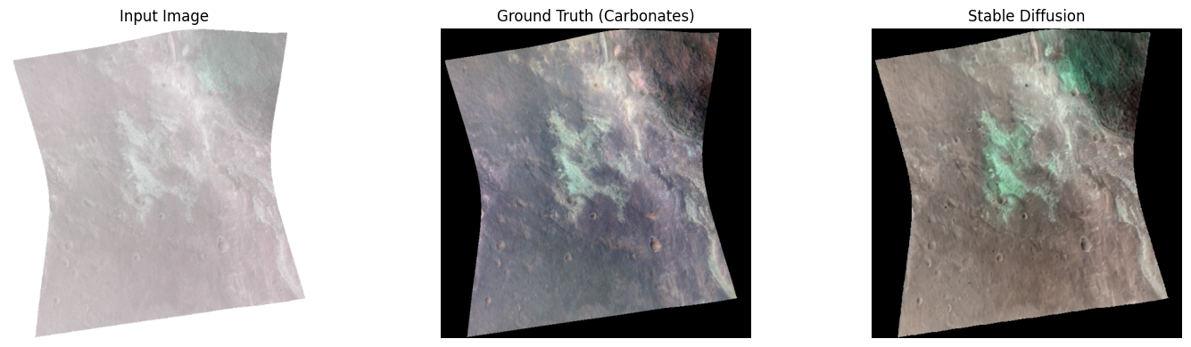

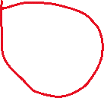

Diffusion model results on PNR Dataset
Metrics | Sd PNR Scores
Average RMSE | 7.097
Average PCC | 0.979
Average Cosine Similarity | 0.980
Average SSIM | 0.826
Average lpips | 0.071
Stable diffusion was much better at predicting carbonates than pnr however there was some bias in predictions

Slide 22
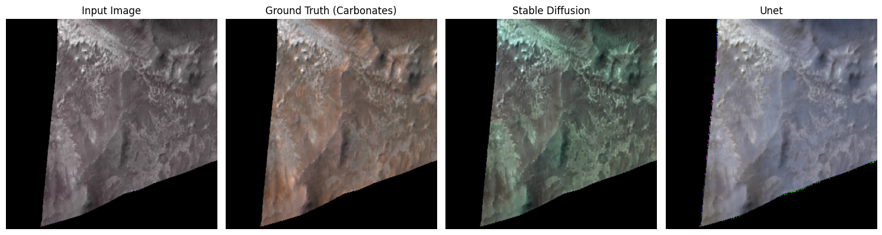




Bias in results
There are some bias possibly due to data skewness and the prompt predict carbonates
It will show the carbonates even if they are not present

Slide 23
Upgrading the model
To remove this bias I first tried to balance the dataset and removed few datasets with no carbonates in them
Carbonates are also location specific, eg. Jezero crater has lot more carbonates present than cooprates
To include this metadata I unfroze the CLIP Text encoder and provided metadata info –
Longitude
Latitude
Location Name
Text – Predict carbonates if present

Slide 24
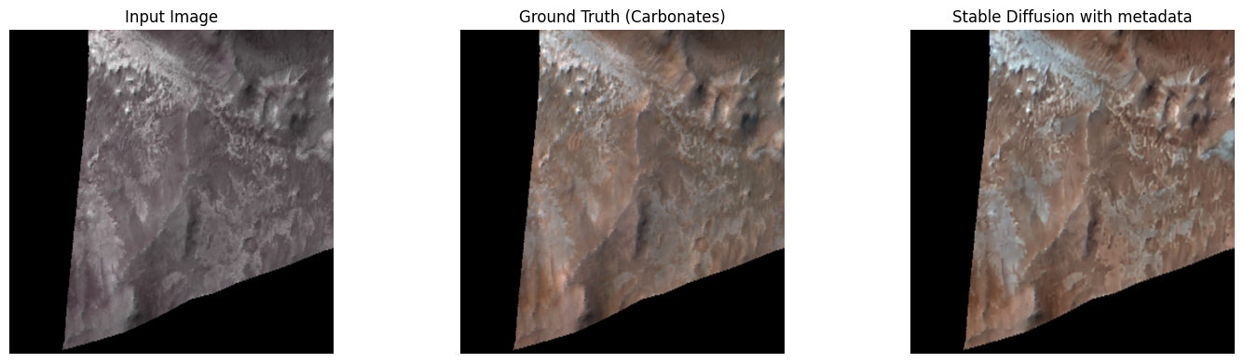
Stable diffusion metadata Results
Metrics | Scores
Average RMSE | 6.743
Average PCC | 0.974
Average Cosine Similarity | 0.983
Average SSIM | 0.833
Average lpips | 0.067
Results were similar however we can observe that SD is no longer predicting carbonates if it’s not present

Slide 25
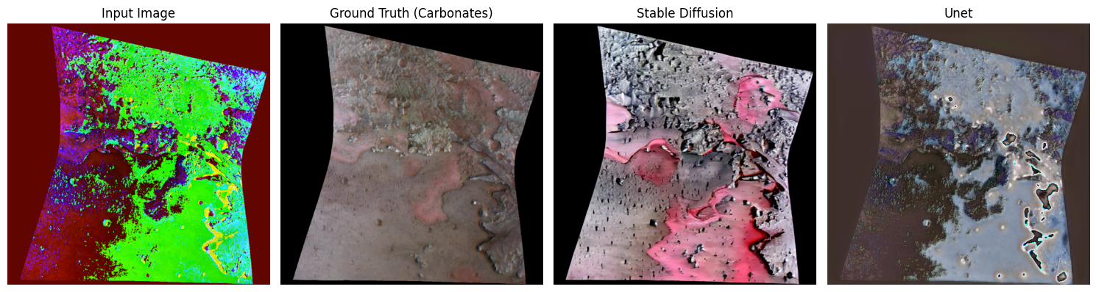
Stable Diffusion on PCA
Stable diffusion did not perform well on pca as compared to other datasets
The model was able to predict carbonates but couldn‘t locate specific pixels and was more like a blob of area

Slide 26
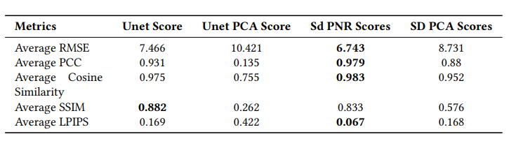
Metrics Comparison
Diffusion Model performs best in almost all metrics

Slide 27
Conclusion
Created a specialized dataset from CRISM products for training.
Implemented U-Net, but it failed to capture carbonate signatures effectively.
Fine-tuned stable diffusion model with CRISM metadata, achieving accurate predictions of carbonate signatures.
Evaluated various datasets to identify the most effective one for accurate predictions

Slide 28
Thanks

Slide 29
Extra Slides

Slide 30
Future Work
Increase Dataset Coverage: Expanding the dataset coverage presents a signifcant opportunity for further improvement.
Architecture Modifcation for Stable Difusion: Adapting the Stable Difusion architecture to accommodate 4-band images is a compelling avenue for exploration.
Incorporate Multi-Sensor Data Fusion: Combining data from multiple remote sensing instruments beyond CRISM could enhance the predictive capabilities of the model.

Slide 31
Recent advancements in diffusion models
Although The use of machine learning models in remote sensing and planetology has been used abudently for various tasks however use of diffusion model is relatively new.
Few use cases and advancements in diffusion models-
Removing clouds from satellite images
Enhance resolution of remote sensing images
Climate Prediction
Liu, Y., Yue, J., Xia, S., Ghamisi, P., Xie, W., & Fang, L. (2024). Diffusion Models Meet Remote Sensing
Le Bellier, G., & Audebert, N. (2024). Detecting Out-Of-Distribution Earth Observation Images with Diffusion Models.

Slide 32
Drawback of Unet over diffusion model for current task
Unet primarily docus on spatial features so cannot capture complex hyperspectral information
Unet assumes pixel-wise dependence while diffusion model could work with independent spectral channels
Diffusion model can better generalize non-linear and intricate patterns and is more robust handling noise and uncertainity
Cao, Z., Cao, S., Wu, X., Hou, J., Ran, R., & Deng, L. (2023). DDRF: Denoising Diffusion Model for Remote Sensing Image Fusion
Unraveling the Temporal Dynamics of the Unet in Diffusion Models. (2023)
CDUNet: Cloud Detection UNet for Remote Sensing Imagery. (2023)

Slide 33
Trade-off between the metrics
RMSE provide pixel/level error however does not capture perceptual quality
SSIM and LPIPS better captures how humans perceive similarity however may not perform with high-noise scenarios or provide precise numerical difference
PCC and cosine similarity better correlation for high dimensional data however does not provide magnitude and perceptual differences
Therefore attempts to increase one might affect the other and a delicate balance needs to be maintained

Slide 34
High Similarity index
The research extends an existing work therefore needed to explain the existing work done by Stepcenkov in detail
01
Needed to provide exact wavelength details as well as product infromation about CRISM and CaSSIS datasets from official sites
02
Required good visual representation to explain the concept of diffusion models
03

Slide 35
Justification for PCA
Requirement : 4 dimention image obtained by implmenting cassis filter needed to be converted to 3 dimention to feed into the diffusion model
Assumtion: If the bands have high correlation then dimention reduction will retain required information needed for predicting new spectral channel
Result: As expected the bands are independent of each other therefore pca struggle to combine them effectively without loosing critical information therefore gave poor results

Slide 36
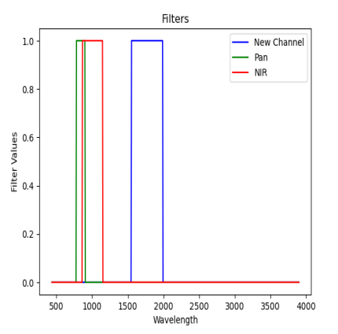
Carbonate prediction based on input channels
I am also applying a rectangular filter to obtain the to include the channels where wavelength range contains more information about the carbonates signatures
Filter 1: 780nm - 900nm
Filter 2: 860nm - 1150nm
Filter 3: 1550nm to 1990nm

Slide 37
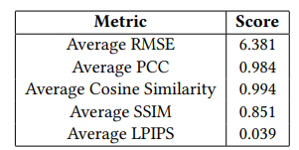
Result of stable diffusion on rectangular filter
Stable diffusion performed best when channels already containing the carbonates signature were provided.
These findings underscore the potential of spectral wavelength selection as a means to enhance mineral detection accuracy

Slide 38
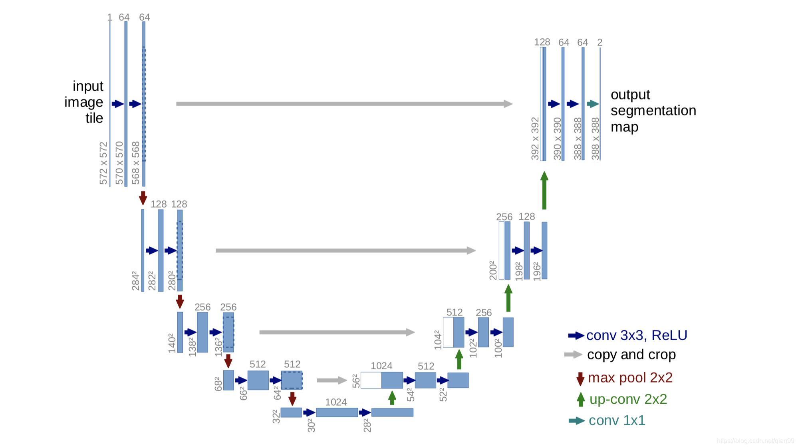
Unet Architecture
The Unet model was chosen as the baseline due to promising results from existing research by Stepcenkov (2022) for visible bands.
Olaf Ronneberger, Philipp Fischer, Thomas Brox , U-Net: Convolutional Networks for Biomedical Image Segmentation

Slide 39
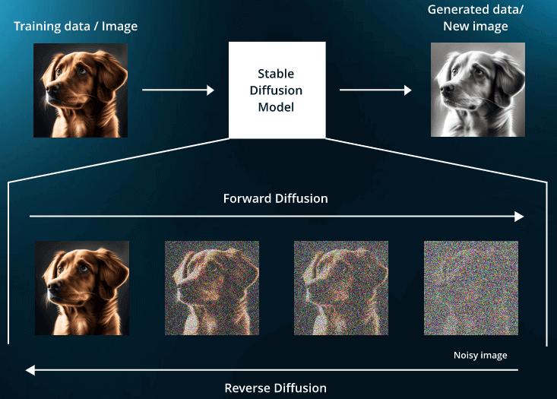
Diffusion models
Diffusion models generate data by progressively adding noise to dataset and then learn to reverse the noise and create new image.
Diffusion models are better at capturing non-linear and intricate patterns of spectral channels
Diffusion models leverages teh independence of sprectral channels
Diffusion models better at handling uncertainity in data

Slide 40
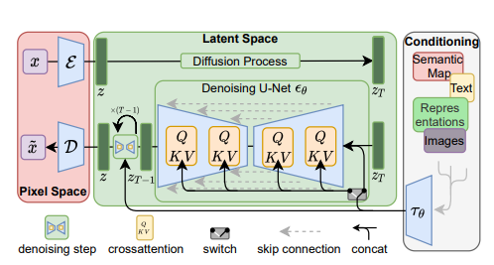
Stable Diffusion
Stable Diffusion is a text-to-image latent diffusion model trained on 512x512 images from a subset of the LAION-5B database.
There are three main components in latent diffusion.
An autoencoder (VAE).
A U-Net.
A text-encoder,
GitHub - CompVis/latent-diffusion: High-Resolution Image Synthesis with Latent Diffusion Models
Notes:
diffusion models are machine learning systems that are trained to denoise random Gaussian noise step by step, to get to a sample of interest, such as an image

Slide 41
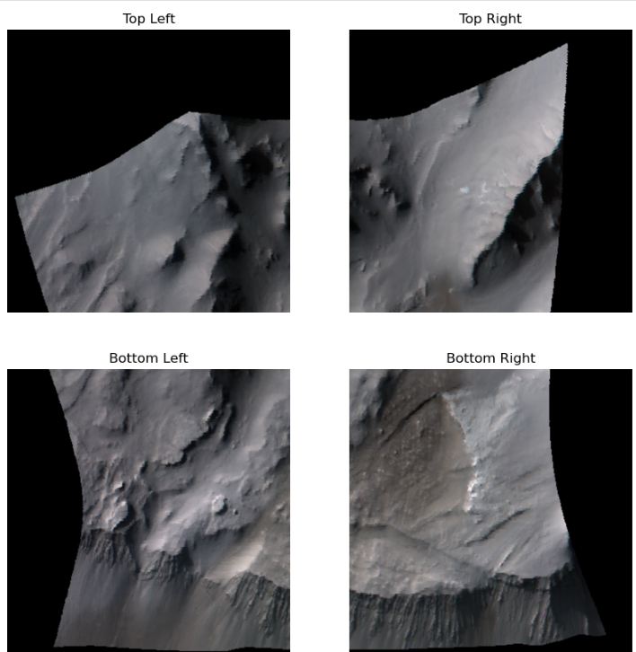
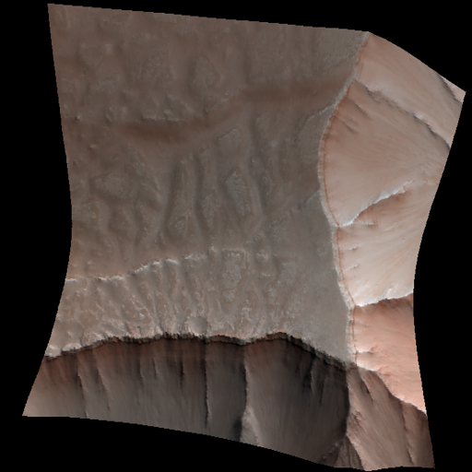
Data Augmentation
Split the image into 4 equal parts
Applied image rotation and image flipping on each parts

Slide 42
Unet Results on PCA dataset
Metrics | Score
Average RMSE | 10.421
Average PCC | 0.135
Average Cosine Similarity | 0.755
Average SSIM | 0.262
Average LPIPS | 0.422

Slide 43
Experimental setup
I used an pretrained instructPix2Pix model with it‘s weights on already trained stable diffusion model
Setup –
Operating system – Ubuntu
GPU - NVIDIA RTX A5000 24564MiB
Hyperparameters
Epocs – 1000
Learning_rate – 5e-05
Resolution- 512x512

Slide 44
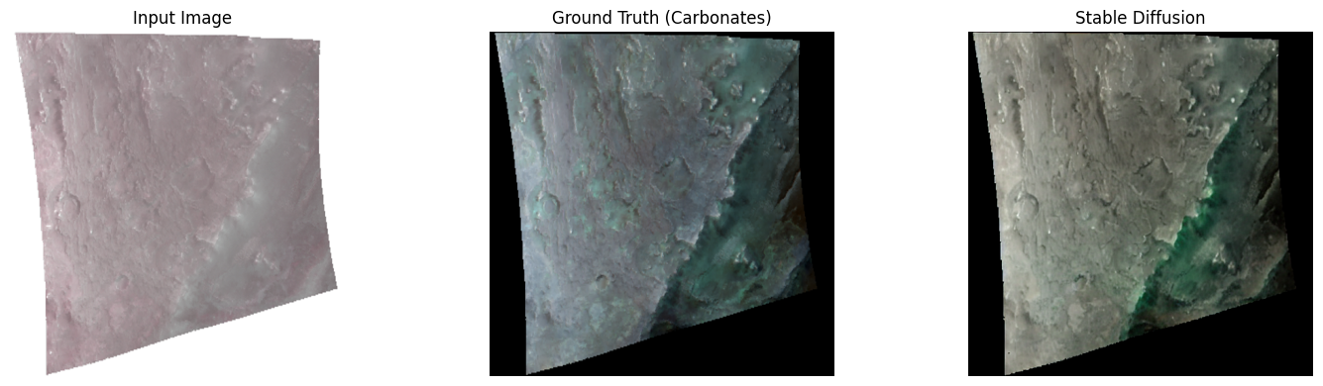



Metrics | Sd PNR Scores
Average RMSE | 7.097
Average PCC | 0.979
Average Cosine Similarity | 0.980
Average SSIM | 0.826
Average lpips | 0.071

Slide 45
Stable diffusion on PCA Metrics
Metrics | Score
Average RMSE | 8.731
Average PCC | 0.880
Average Cosine Similarity | 0.952
Average SSIM | 0.576
Average LPIPS | 0.168
Metrics are also worse than pnr dataset

Slide 46
Refrences
Robin Rombach1 , Andreas Blattmann1 ,Dominik Lorenz1,Patrick Esser Bjorn Ommer ,1 High-Resolution Image Synthesis with Latent Diffusion Models by
Tim Brooks , InstructPix2Pix: Learning to Follow Image Editing Instructions
https://github.com/huggingface/diffusers
https://github.com/qubvel/segmentation_models.pytorch
Olaf Ronneberger, Philipp Fischer, Thomas Brox , U-Net: Convolutional Networks for Biomedical Image Segmentation
Zifeng An Zijing Xu Eric Fan Qi Cao, Enhancing Visual Realism: Fine-Tuning InstructPix2Pix for Advanced Image Colorization
Remote Sensing | Free Full-Text | Learning the Link between Albedo and Reflectance: Machine Learning-Based Prediction of Hyperspectral Bands from CTX Images (mdpi.com)

